Slide 1
Word Formation
repeat – repetition
appear – appearance

Slide 2
appear, connect, express, confer, educate, refer, dominate, dictate, protect, attract, prefer
ance/ence
(t)ion
appearance
conference
reference
dominance
preference
connection
expression
education
dictation
protection
attraction

Slide 3
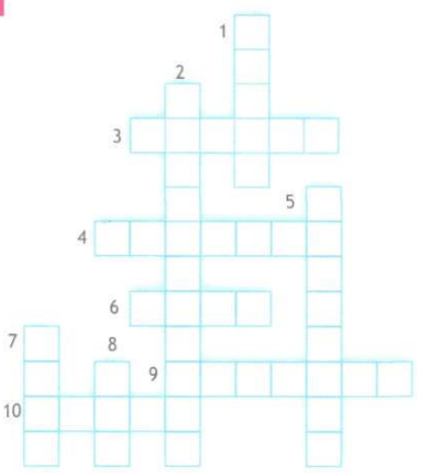
w
a
s
d
l i t t e r
s
a
e
i
c a p t a i n
p
e
a
r
e
d
a
c
t
i
v
e
t
a m
l
o
f
o
g
u b b
s h
s m
k
e

Slide 4
ing form
I saw/noticed … + Ving
I look forward to + Ving
I spent time + Ving
Infinitive
I wanted + to V
It was fantastic/great/unusual + to V

